Slide 1

Investment Analysis: Home sale prices in Ames, Iowa
Presented By: Kevin Khe

Slide 2
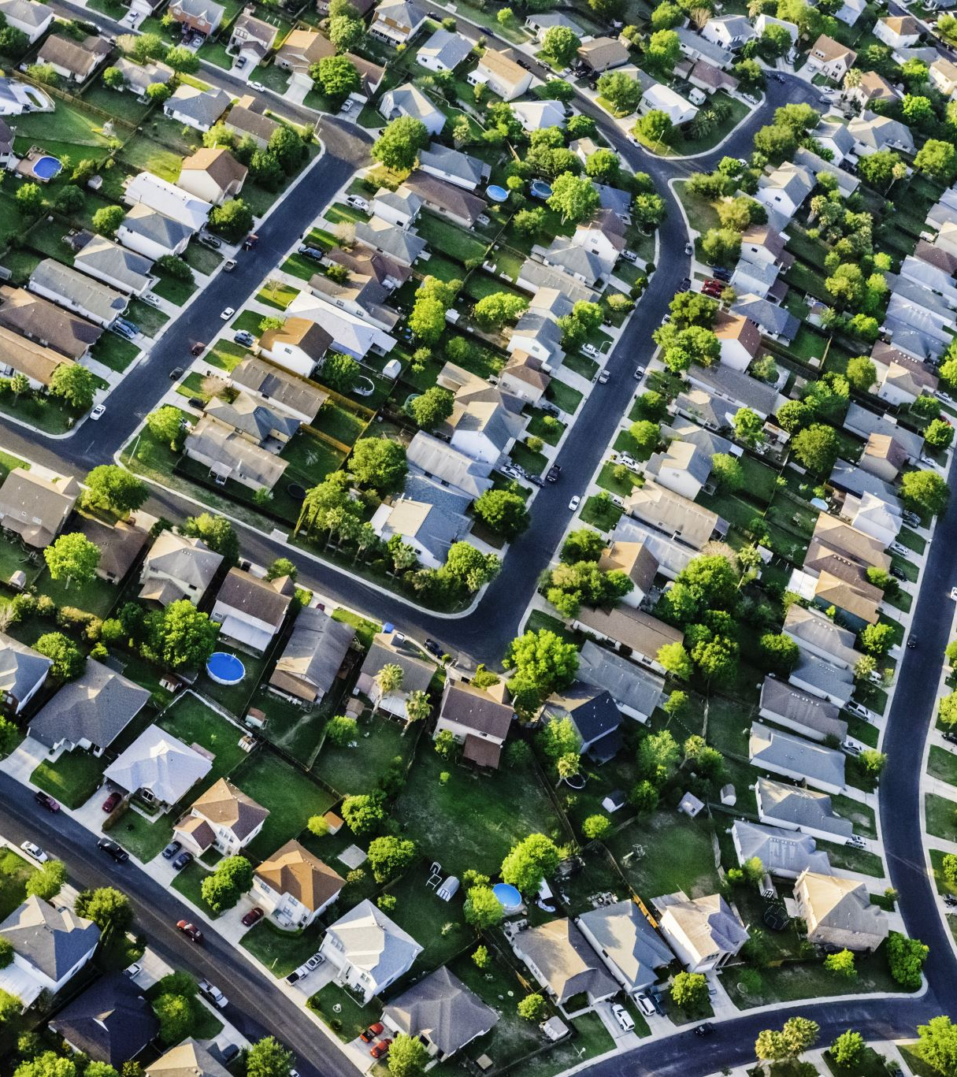
Project Goal: Analyze key factors that drive home sale prices
1. Homestyle floors
2. Bedrooms
3. Overall Quality
4. Lotarea
5. Central air

Slide 3
Data Set Description
1460 residential homes sold
Ames, Iowa from 2006 – 2010
79 variables describing each home (categorical and continuous)
Avg sale price = $180,921

Slide 4
Hypothesis
1.Null Hypothesis- There is no significant difference in home prices based on Homestyle floors
Alternative Hypothesis- There is a significant difference in home prices based on Homestyle
floors
2.Null Hypothesis- There is no significant difference in home prices based on Bedrooms
Alternative Hypothesis- There is a significant difference in home prices based on Bedrooms
3. Null Hypothesis- There is no significant difference in home prices based on Overall Quality
Alternative Hypothesis- There is a significant difference in home prices based on Overall Quality
4. Null Hypothesis- There is no significant difference in home prices based on Lot area
Alternative Hypothesis- There is a significant difference in home prices Lot area
5. Null Hypothesis- There is no significant difference in home prices based on Central Air
Alternative Hypothesis- There is a significant difference in home prices Central Air

Slide 5
Process
Collected data on each of the five variables and conducted two different statistical analysis tests to produce accurate and telling results
Descriptive Analysis and Two sample T-test was used for each variable
The distribution was found for each of the variables along with the P-value which was used to determine whether the Null Hypothesis was rejected or not

Slide 6
Analysis of Homestyle floors 1 floor vs 2 floor
Compare and test between homes with One floor or Two floors
Average home price
Avg One floor price = $175,645
Avg Two floors price= $210,051
Conclusion: the Null hypothesis is rejected
We found that the P-Value was less than the alpha of .05
So we can confidently say that there is a significant difference in home sale prices based on home style floors

Slide 7
Analysis of Bedroom Count
Tested to see if a greater number of bedrooms was important
This variable seems to have a minor effect
Avg <= 3 price = $173,979.0
Avg >3 price = $214,683.4
Conclusion: The Null Hypothesis is to be rejected with the P-value 2.62632E-08 being smaller than the alpha of .05
There is a significant difference based on the bedroom count

Slide 8
Analysis of Overall Quality
Determine whether if overall quality rating on a scale from 1-10
Average score = 6.1
Chose Two scores: 5 and 8
Avg ”5” price = $266,375.7
Avg “8” price = $546,219.7
Conclusion: The Null Hypothesis fails to be rejected due to the P-value being greater than the alpha of .05
There is no real significance in home prices based on Overall Quality

Slide 9
Analysis of Lot Area
Targeted the Lot Area size to determine whether if consumers cared for size of the lot.
Average Lot area= 10,516 sqft
We tested <=10,000 and >10,000 sqft
Avg price <=10,000 = $239,555.1
Avg price >10,000 = $254,175.6
It seems that large lot areas can still be much cheaper than smaller lot areas
Conclusion: The Null Hypothesis fails to be rejected due to the P-value being .31 greater than the alpha of .05
There is no real significance in home prices based on the Lot Area

Slide 10
Analysis of Central Air
Tested between home with and without a central air system
Avg price ”yes”= $186,186.7
Avg price ”no”= $105,264.0
Results seem to show consumers have a higher regard for central air systems
Conclusion: The Null Hypothesis is rejected due to the P-value 2.2025583150045E-37 being less than the alpha of .05 There is a significance in home prices based on a home having central air

Slide 11

Final Recommendations
According to the findings, we suggest that money for the mortgage-backed securities should be allocated in the market of homes with these three variables
Bedrooms that’s are >3
Homes with two floors
Homes with central air

Slide 12
Thank You
By: Kevin Khe

